Slide 1
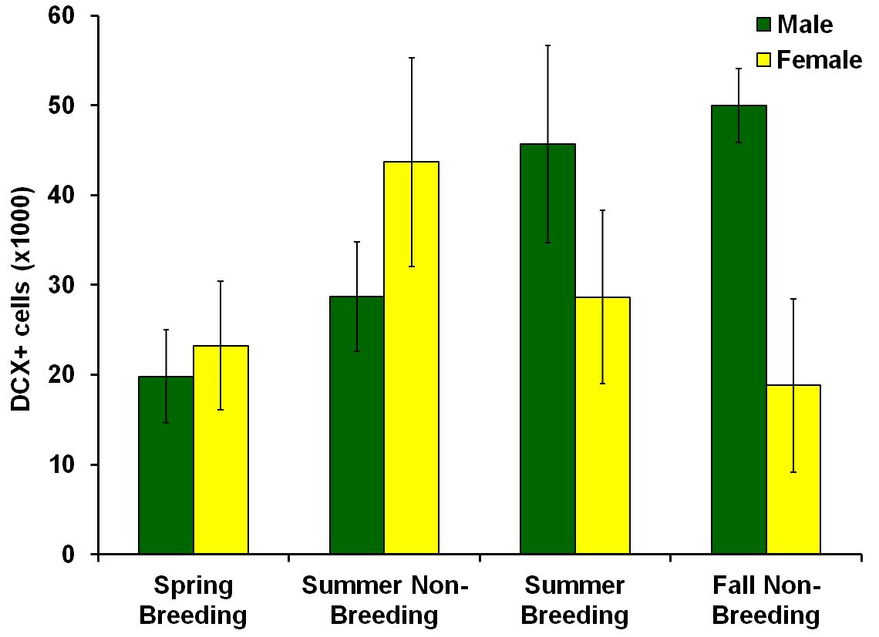
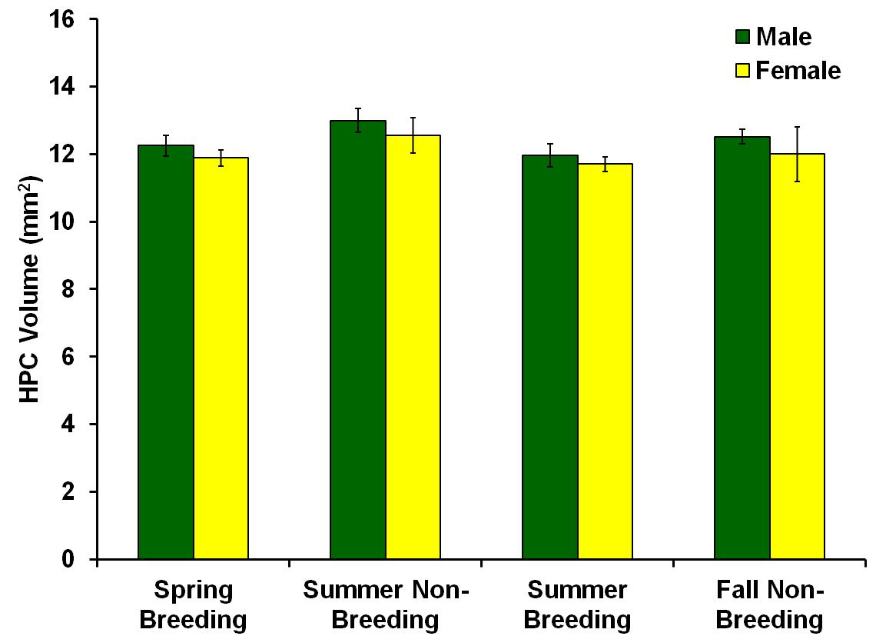
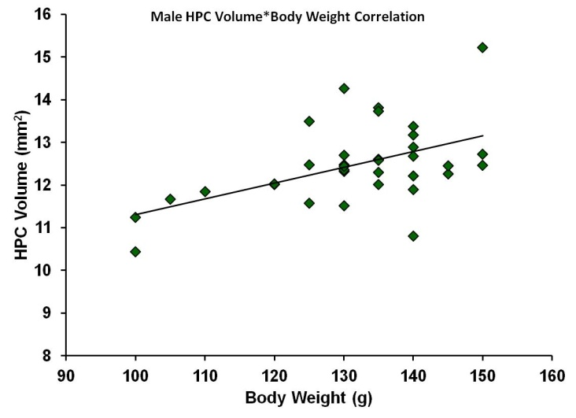
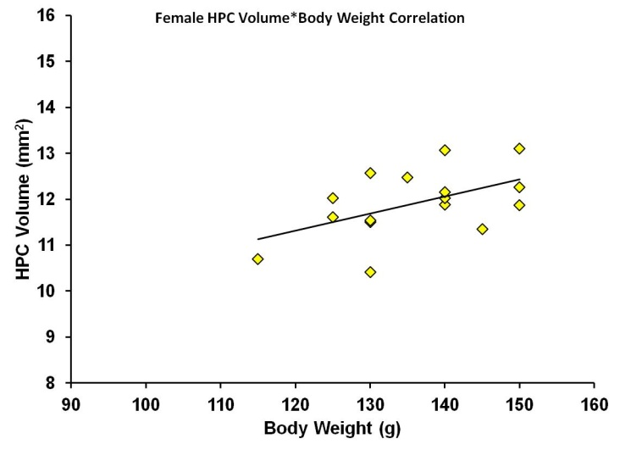
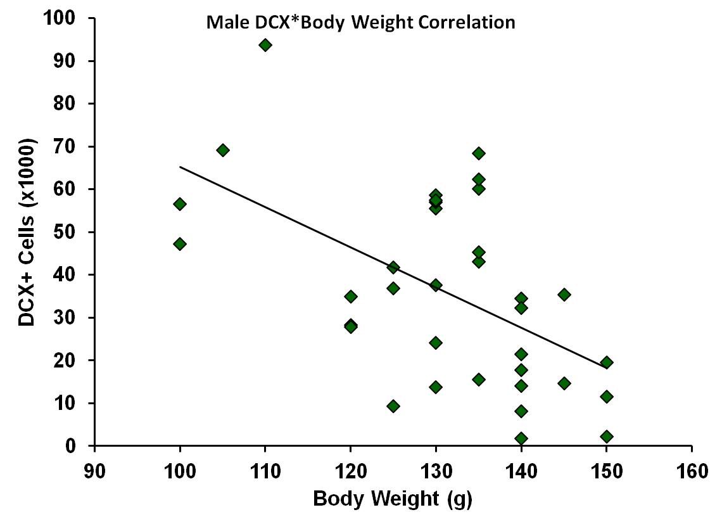
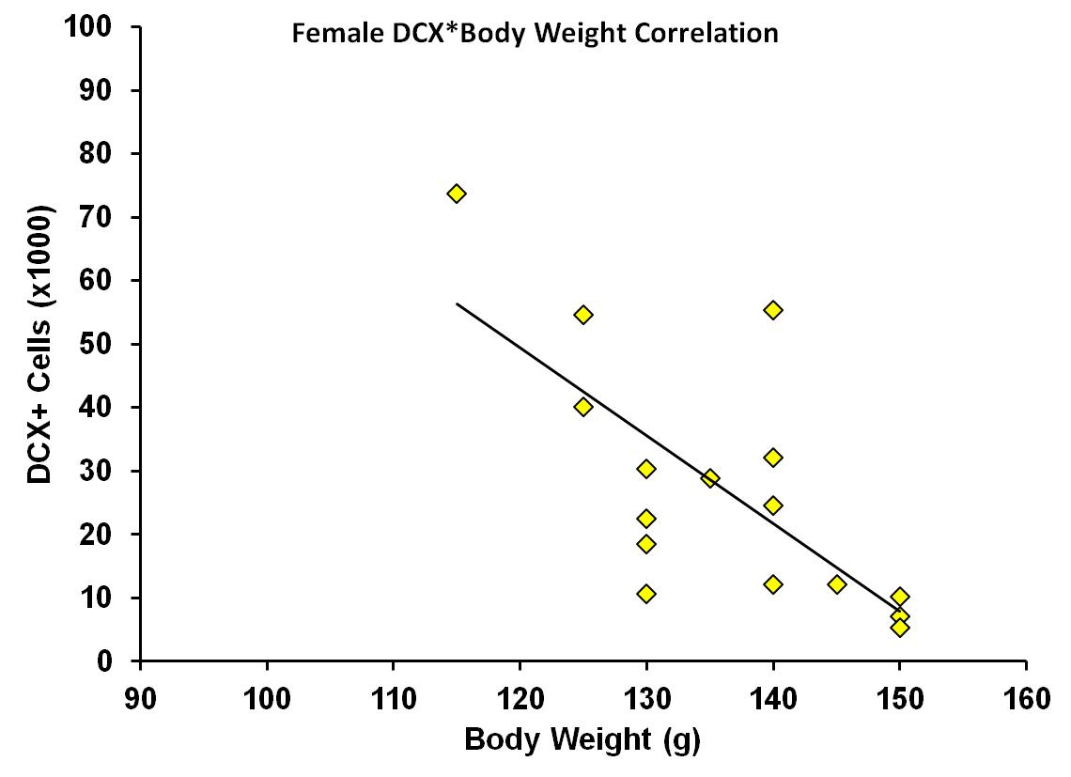
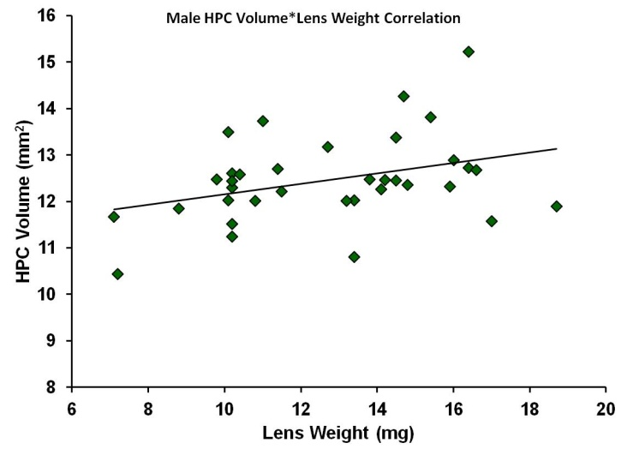
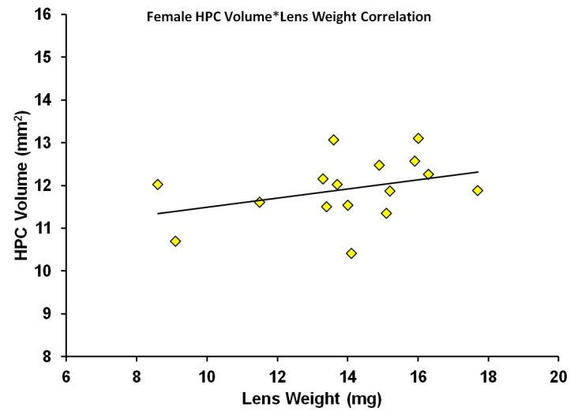
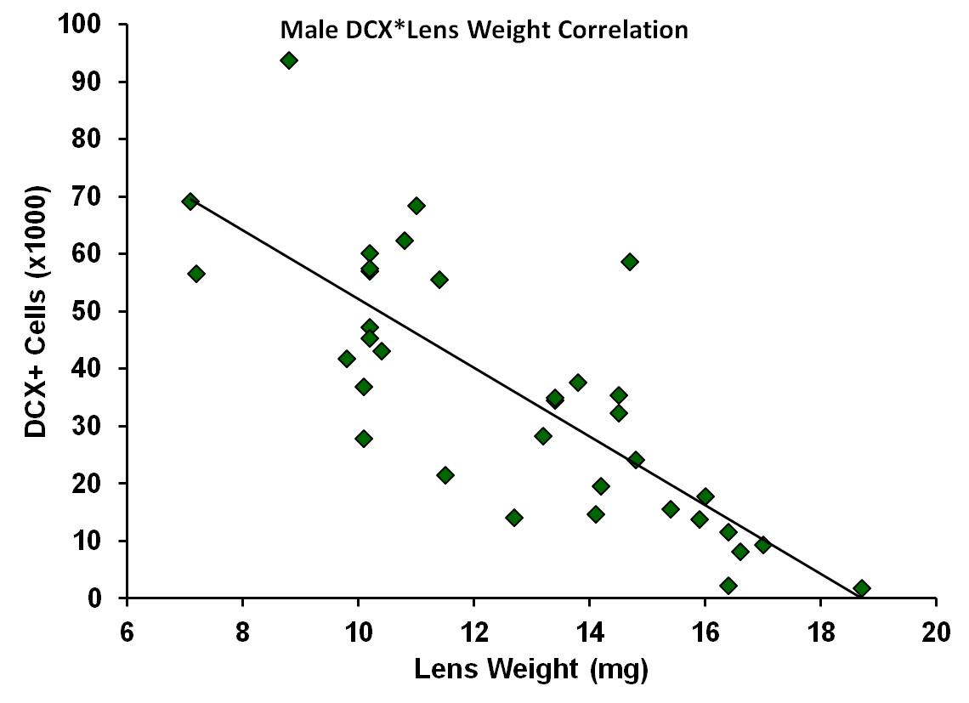
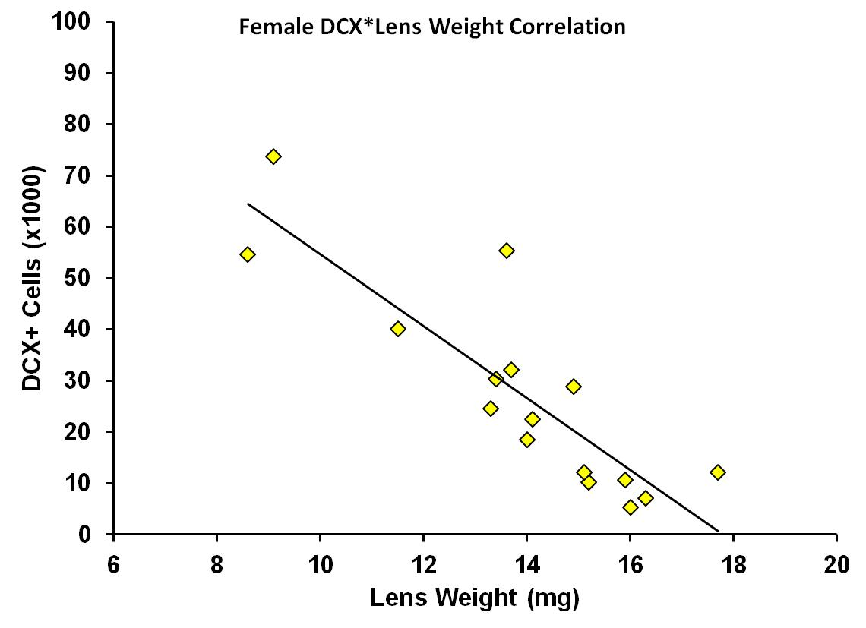
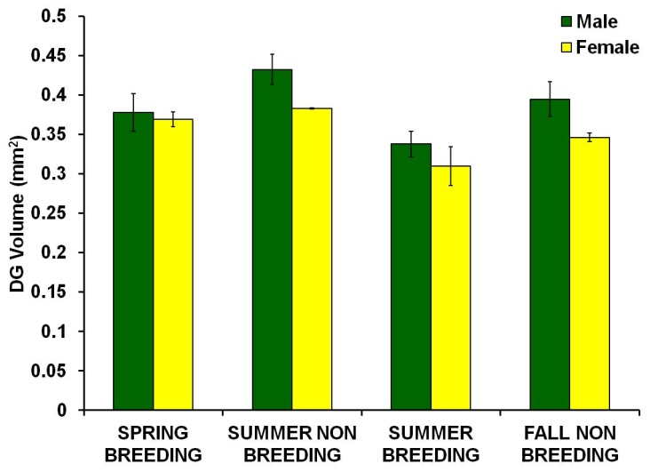
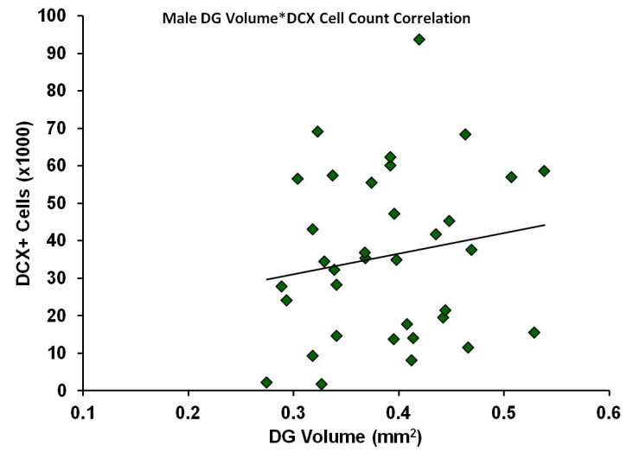
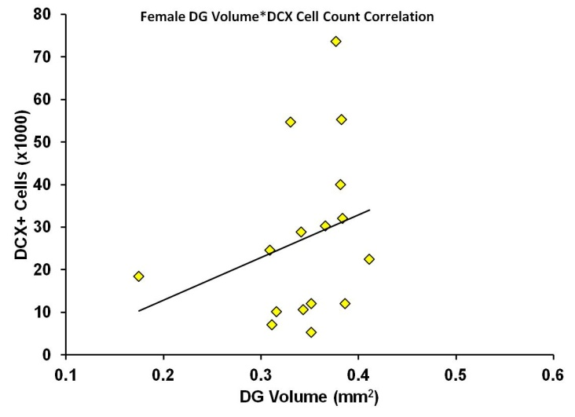
Hippocampal Neurogenesis Varies Seasonally in Male Eastern Chipmunks
Gavin A. Scott¹, Rachel Dasendran¹, Hugo Lehmann², Andrew N. Iwaniuk³ & Deborah M. Saucier¹
¹Faculty of Science, University of Ontario Institute of Technology, Oshawa, ON, Canada
²Psychology Department, Trent University, Peterborough, ON, Canada
³ Department of Neuroscience, University of Lethbridge, Lethbridge, AB, Canada
Background
Hippocampal Neurogenesis
Hippocampal Volume
The hippocampus (HPC) is a structure known to play a critical role in spatial memory¹. The HPC also exhibits adult neurogenesis and these new neurons are thought to play a role in establishing and maintaining new memories².
Some research on wild species suggests that both HPC neurogenesis and volume are sexually dimorphic and fluctuate across seasons in accordance with sex and seasonal differences ^{3,4,5}.
Specifically, it is thought that in polygamous rodents, neurogenesis should be lowest during mating season and lower in females than in males due to the effects of sex hormones⁶. Additionally, HPC volume should increase in males during the mating season due to greater ranging⁷.
However, research on this subject in mammals is sparse, and there are inconsistencies across species. Evidence from more species would be beneficial to the field.
Accordingly, we examined HPC neurogenesis and volume in the Eastern Chipmunk, Tamias Striatus, a hibernating rodent that has two breeding seasons and in which both males and females hoard food in the fall.
A 2x4 ANOVA revealed no significant main effect of sex or season, nor a significant sex*season interaction. However, the interaction approached significance (p = .08) and power was an issue because of low samples in the female condition (e.g., n =2 in one group). Thus, we conducted LSD tests and still found these significant differences:
Sex Differences
In the Fall Non-Breeding Season, males had higher neurogenesis than females (p <.05).
Seasonal Effects
Males exhibited a seasonal effect with more neurogenesis in the Summer Breeding and Fall Non-Breeding seasons than the Spring Breeding season (ps <.05).
A 2x4 ANOVA revealed no significant main effects of sex or season, nor a significant sex*season interaction.
However, when ANCOVAs were conducted to control for age-related factors, males had significantly greater HPC volume than females when controlling for both body weight (F_{(1,42)} = 5.4, p <.05) and lens weight (F_{(3,42)} = 4.79, p <.05).
Controlling for body weight as an index of age
Controlling for body weight as an index of age
HPC volume and body weight were positively correlated in both males (r₍₃₅₎ = .51, p <.01) and females (r₍₁₆₎ = -.52, p <.05). One-way ANCOVAs run separately on each sex revealed no effect of season in either sex.
Controlling for lens weight as an index of age
HPC volume and lens weight were positively correlated in males (r₍₃₅₎ = .36, p <.05) but not females (r₍₁₆₎ = .36, p = .18). One-way ANCOVAs run separately on each sex revealed no effect of season in either sex.
Methods
Neurogenesis and body weight were negatively correlated in both males (r₍₃₅₎ = -.55, p <.05) and females (r₍₁₆₎ = -.71, p <.05), suggesting that age might be a better predictor of neurogenesis.
When factoring in body weight as a covariate the Males still showed a seasonal effect with more neurogenesis in the Fall Non-Breeding season than the Spring Breeding and Summer Non-Breeding Seasons (ps <.05).
The Females also now showed a seasonal effect with more neurogenesis in the Summer Non-Breeding season than in all other seasons (ps <.05), but this group was too small to make meaningful conclusions.
Trapping
Chipmunks were trapped from April to October using live traps baited with peanuts or sunflower seeds. Pregnant or lactating females were released, as well as juveniles.
Perfusions and Histology
Within 3 hours of capture, the chipmunks were removed from the traps, anesthetised, weighed, and perfused in the field. The brains were removed, post-fixed, and sectioned at 40 µm on a freezing microtome.
Immunohistochemistry and Stereology
Every twelfth section through the dentate gyrus (DG) was labeled for doublecortin (DCX), a marker for immature neurons.
DCX+ granule cells were counted throughout the entire DG using unbiased stereology⁸.
The volume of the DG and the entire HPC were quantified using the Cavalieri point-counting method⁸ on Nissl stained sections.
Spring Breeding (Apr)
Summer Non-Breeding (May)
Summer Breeding (June-July)
Fall Non-Breeding (Aug-Oct)
Controlling for lens weight as an index of age
Conclusions
The present findings demonstrate the phenomenon of adult neurogenesis in the Eastern chipmunk, which is the first report of its kind, to our knowledge, in this particular species.
We found that in male chipmunks, neurogenesis was highest in the fall. However, the effect was better predicted by an age-related factor (lens weight). Similarly, neurogenesis in the female chipmunks was stable across seasons. Thus, neurogenesis does not truly fluctuate across seasons in the chipmunk.
Despite not finding any significant sex differences in neurogenesis, we found greater HPC volumes in the males than in the females when controlling for age. This type of finding is common in mammals.
Therefore, despite seemingly finding changes in neurogenesis across seasons and sex, a validated marker of age (lens weight), was the best predictor of neurogenesis. The decrease in neurogenesis with age is a well established phenomenon.
Future studies must therefore more accurately factor in age when examining sex and seasonal changes in neurogenesis.
Field Season
We found that the Eastern Chipmunk exhibits high rates of adult neurogenesis which, to our knowledge, has never before been reported in this species.
We found evidence of seasonal variation in neurogenesis. However, this variation is likely best explained by differences in age.
Neurogenesis and weight weight were negatively correlated in both males (r₍₃₅₎ = -.79, p <.001) and females (r₍₁₆₎ = -.87, p <.001), again suggesting that age might be a better predictor of neurogenesis.
When factoring in lens weight as a covariate the Males and the Females no longer showed a significant seasonal effect.
Dentate Gyrus Volume
Photomicrograph of DCX+ cells (red) in the chipmunk dentate gyrus counterstained with DAPI (blue).
References
An effect of season was found in the males, whereby DG volume was larger in the Summer Non-Breeding season than in the Summer Breeding season (p <.05).
Controlling for body weight or lens weight did not change this result.
No sex differences were found.
Neurogenesis and DG volume were not significantly correlated in either sex.
Morris RG, Garrud P, Rawlins JN, O’Keefe J (1982) Place navigation impaired in rats with hippocampal lesions. Nature 24:681–683.
Marín-Burgin A, Schinder AF (2012) Requirement of adult-born neurons for hippocampus-dependent learning. Behav Brain Res 227:391–399.
Burger DK, Gulbrandsen T, Saucier DM, Iwaniuk AN (2014) The effects of season and sex on dentate gyrus size and neurogenesis in a wild rodent, Richardson’s ground squirrel (Urocitellus richardsonii). Neuroscience 272:240–251.
Burger DK, Saucier JM, Iwaniuk AN, Saucier DM (2013) Seasonal and sex differences in the hippocampus of a wild rodent. Behav Brain Res 236:131–138.
Galea LAM, McEwen BS (1999) Sex and seasonal differences in the rate of cell proliferation in the dentate gyrus of adult wild meadow voles. Neuroscience 89:955–964.
Galea LAM (2008) Gonadal hormone modulation of neurogenesis in the dentate gyrus of adult male and female rodents. Brain Res Rev 57:332–341
Sherry DF, Jacobs LF, Gaulin SJ (1992) Spatial memory and adaptive specialization of the hippocampus. Trends Neurosci 15:298–303
Mouton PR (2002) Principles and Practices of Unbiased Stereology: An Introduction for Bioscientists, 1st ed. Baltimore, Maryland: The John Hopkins University Press.
Epp JR, Barker JM, Galea LAM (2009) Running wild: neurogenesis in the hippocampus across the lifespan in wild and laboratory-bred Norway rats. Hippocampus 19:1040–1049.
Age Estimation
In order to provide a relative measure of age to be used as a covariate in our analyses, two factors were considered:
Body weight
Eye lens weight⁹.
Notes:
BACKGROUND
It has been established that memories reorganize with time.
The theory of systems consolidation suggests that memories are initially dependent on the HPC, gradually become independent of it, and entirely dependent on the ACC where they are more permanently stored.
Evidence for this demonstrates an increase in HPC activation at a recent, but not remote, time and an increase in ACC at a remote, but not recent, time.
Similarly, damage to the HPC causes RA for recent memories leaving remote memories intact and damage to the ACC causes RA for remote memories leaving recent memories intact.
Although these results provide evidence for systems consolidation, it is possible that this increase in ACC activation at a remote time is not a reflection of systems consolidation but is a reflection of greater cognitive processing needed to retrieve older memories (e.g., of forgetting).
Therefore, the current study examined…

