Slide 1
EVALUATING PROCEDURAL JUSTICE IN REGIONAL PLANNING PROCESS: LESSONS FROM ALBERTA’S REGIONAL PLANS
Parastoo Emami
Supervisors: Professor Bjornlund and Professor Xu
Department of Geography University of Lethbridge
Fall, 2014

Slide 2
Index
Introduction
Background
Literature
Methodology
Findings:
Procedural justice components
Procedural justice models
Conclusion
Contributions
Limitation

Slide 3
Introduction
Water planning and management challenges:
Climate change
Increasing demands
Various users (urban, agriculture, industrial)
Governments and the society have become more sensitive
Procedural justice is one of the main pillars
fair allocation of resources,
adds transparency to the process,
improves public acceptance and legitimacy of water plans
A fair water management and plans
Fairness is a multifaceted concept.
Syme, et al., 1999, Stern, 2010, Trobst, et al., 1990, Caraddock, et al., 1999, Bjornlund, 2010

Slide 4
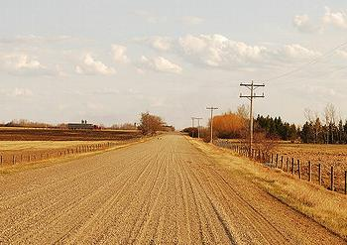
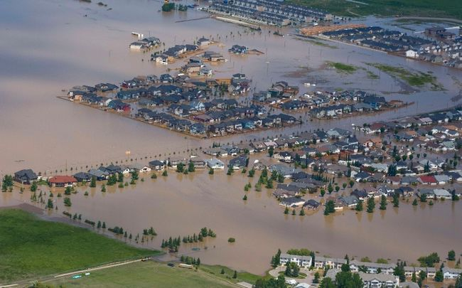
Background
Water management real challenge in Alberta
Laws, regulations, and policies:
Riparian Doctrine (1870) --- Water Act (2000)
Water for Life – Alberta’s strategy for Sustainability (2003)
In 2008, new environmental management approach was adopted
Integrated Resource Management (IRM)
Cumulative Effect Management System (CEMS)
Alberta drought (2010)
Alberta flood (2013)
Toronto Sun, 2013, Environment news service, 2010, Bjornlund, 2010, Bjornlund and Klein, in press

Slide 5
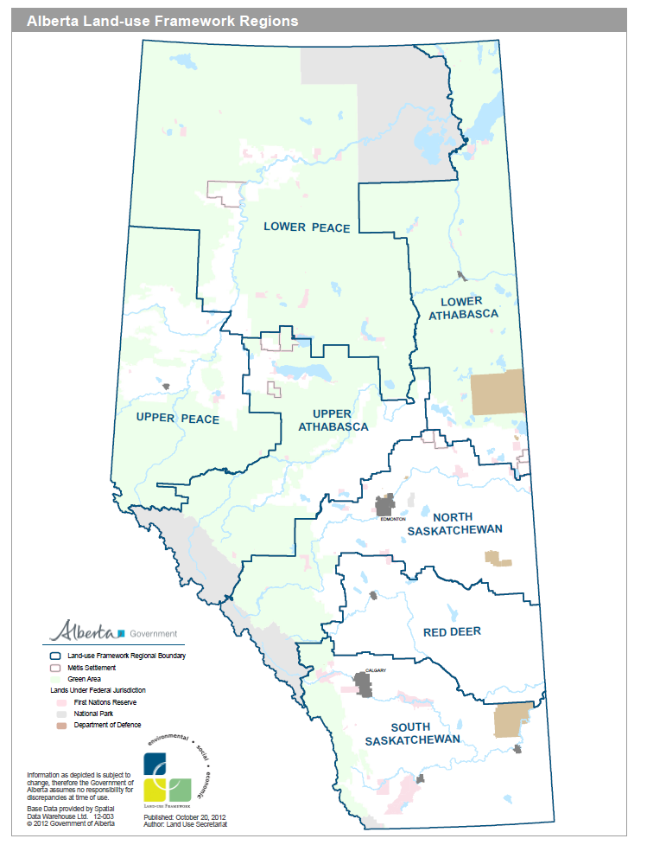
Background
New management approach:
Land-Use Framework (2008) (LUF)
Alberta Land Stewardship Act (2009)
ALSA (2009) divides Alberta
Seven regions
Lower Athabasca
South Saskatchewan
Region’s characteristics / challenges
Oil sand industry development
Intense population growth
Alberta Environment, 2008, 2009, 2010

Slide 6
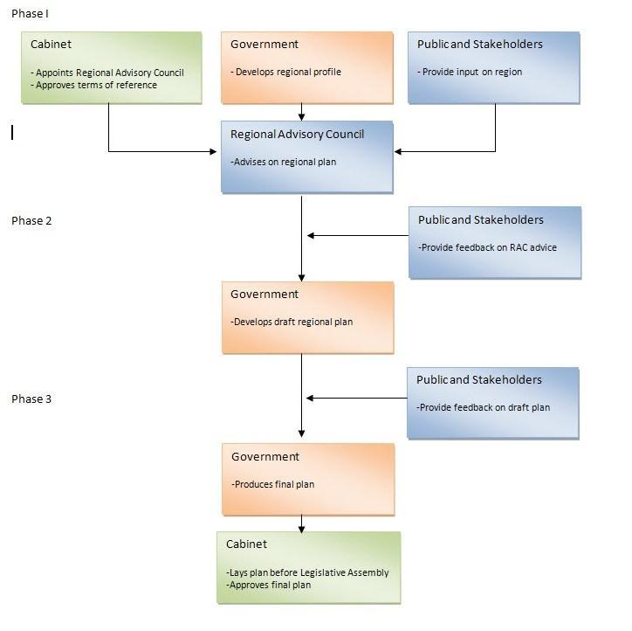
Background
Regional plans
Legal documents
Broad strategic plans
Subject to regular reviews
RP administration:
Land use Secretariat
Regional Advisory Council
In case of conflict
RP prevail over all water, land, and air legislations.
RP challenges:
Ambiguity and unclearness
relationships and responsibilities
Alberta Environment, 2010, Lavelle, 2012, de Loë, 2009

Slide 7
Research objectives
The broad goal: social justice in water management and planning
Research objectives:
Develop a theoretical framework
Evaluate procedural justice in Alberta regional plans
Identify critical components of procedural justice
Research questions:
How did the public and stakeholders in Alberta perceive the fairness of the regional planning process?
What are the critical components of procedural justice in Alberta’s regional planning process?

Slide 8
Literature review
change
The tensions and challenges the way water is viewed and manages
The effect of social, economic, and environmental forces in the hydro-political process:
Challenges IWRM:
complex issue of decision making and integrating various sectors
Integrated Water Resource Management (IWRM):
Manages water and land
maximizes economic and social welfare in an equitable manner
encourage multiple actors/agents decision making process
rise
probability conflict and injustices in water allocation
Allan, 2005, GWP-TAC4, 2000, Saravanan, et al., 2009, Bogardi, 1994

Slide 9
Literature review
Issues of justice :
resources are not equally distributed between groups, or
resources are (or are perceived to be) in short supply
Social justice:
a fair and equal society in which each individual matters, their rights are recognized and protected when decisions are made
School of thoughts
Various perspectives
Theories of justice
Egalitarianism
Liberalism
Utilitarianism
Theories of justice
Economic
Social
Environmental
Social Justice
Equity
Procedural Justice
Distributive Justice
Wenz,1988, Nozick,1974, Rawl, 1999, Patrick, 2012, Clayton, 2000, Lundy, 2011, Hamowy, 2004
Notes:
Economic
Libertarian theory: Issue of justice through free market
Efficiency theory: advocates a free market where there is a minimal State that protects private property
Cost-benefit- analysis: the option with the greatest benefits
Social
Human Rights: provides a means of settling disputes by appealing to fundamental human rights
Utilitarian theory: provides a rationale for making decisions
Rawl’s theory (justice ): alternatives offer the most help for the worst off
Environmental
Bio-centric Individualism: value in every living thing
Eco-centric Holism: is a view that people should limit their activities for health of ecosystems.
Precautionary Principle: when development has the potential to impact negatively on the environment

Slide 10
Literature review
Unbiased Framework
Accuracy of information
Minimizing bias
Informative Procedure
Providing Knowledge
Preparing public for effective participation
Ease of operation
Legitimate Representative
Unbiased selection of agents
Right to participant
Equal opportunity to participant
Active Participation
Voice
Control on process
Control on making final decisions
Resolving Conflict
Identifying shared value
Fair decisions
Providing compensation
Correctability
Consistency
Procedural justice:
examines each step of the decision-making process
and evaluates whether it is just
There are three main theories:
Theory of procedure (Thibaut and Walker, 1975) = resolve conflict
Justice judgment theory (Leventhal, 1980) = procedural justice components
Group value model (Lind and Tyler, 1988) = procedural justice in decision making
Develop a theoretical framework
Procedural fairness for civil dispute resolution (Solum, 2004)
Social justice in water management (Syme and Nancarrow, 2001)
Solum, 2004, Lukasiewicz et al., 2013, Syme et al., 2001, 2005, Thibaut and Walker, 1975

Slide 11
Methodology
Procedural justice: moral and philosophical aspect of human psychology.
Many scholars uses qualitative method to conduct the research
Data collection: four sources
Rigor and confidentiality
Government documents
Law, regulation, and policies
In-depth interviews
Local /Provincial Government
Public documents
Observations
Regional planning documents
Regional Advisory Council
Stakeholder
Blog Posts
Websites
Stakeholders meeting
Public meeting
Water conversation
Total 98 documents
Total 16 participants
Total 100 documents
Total 30 hours
Lawrence, et al.,1997, Lukasiewicz et al., 2013, Syme et al., 2001, 2005

Slide 12
Methodology
Data analysis:
Two methods: Thematic analysis and content analysis
Nvivo
Content Analysis
Thematic Analysis
Use a word query
Create a codes from the result of the word Query
Create a hierarchy structure
Creating the themes
Comparing themes with the key words and criteria from literature
Create a hierarchy structure
Creating the themes
Comparing themes with the key words and criteria from literature
Code in NVivo (paragraph or sentences)
Weber, 1990, Liamputtong, 2009, Krippendorf, 1980, Stemler, 2001

Slide 13
Methodology
In-depth interview participants:

Slide 14
Procedural justice components
Identified procedural justice components:
categorized three groups
Designing a fair process
Procedural rules
Clear vision and objectives
Public engagement process
Unbiased representation
Decision making process
Decision-making authorities and responsibilities
Effective public participation strategies
Voice
Understanding conflicts and gaps
Understanding implementation challenges
Designing a fair process
Public engagement process
Decision making process

Slide 15
Procedural justice components
The results reveal that:
the way that the process is designed effects the fairness
A fair planning process
follows procedural rules
has clear visions and objectives
Cumulative Effect Management System (CEMS)
Integrated Resource Management (IRM)
Clarification of the current regional visions and objectives
Clarification of the current definition public participation and consultation
Consistency in the planning process
Transparency in the planning process
Using accurate information
Comprehensible and easy to follow
Ethicality
Procedural rules
Clear visions and objectives

Slide 16
Procedural justice components
The results also show that:
The consultation process needs to be improved
Unbiased representation
Public engagement strategies
Effective public participation
Advertising public participation opportunities
Using effective public engagement tools
Using focus group to manage public participation
Unbiased selection of Regional Advisory council (RAC)
Clarifying RAC’s responsibilities
Value the public input
Bilateral Communication
Public engagement strategy
Unbiased representation
Effective public participation
“ I do not know that for sure [if you can get any response back]” (KI#16)

Slide 17
Procedural justice components
To improve the decision making process:
Decision making authorities and responsibilities
Gaps and conflicts
Implementation challenges
Understanding the value conflicts and gaps
Designing an appealing mechanism and providing compensations (correctability)
Lower Athabasca Region
South Saskatchewan Region
Implementation challenges
Land Use Secretariat and Cabinet
Limiting lobbying and political decisions
Gap and conflicts
Decision making authorities and responsibilities
In SSRP, “the plan’s outcomes are so high level [and general]… implementing them will challenging” (KI#2)
“ WPAC are not working with LARP. LARP has own team ” (KI#16)

Slide 18
Procedural justice model
Plan design
Public consultation process
Decision making process
Theme 1
Theme 2
Theme3
Theme4
Theme5
Theme6
Theme7
Theme 8
Consistency
CEMS
Unbiased selection of RAC
Advertising public participation opportunities
Value of the public input
Clarifying role of Land use Secretariat and Cabinet
Understanding the value conflicts and gaps
LARP
Transparency
IRM
SSRP
Clarifying RAC’s responsibilities
Bilateral communi-cation
Accuracy
Clear vision and objectives
Using effective public engagement tools
Limiting lobbying and making political decisions
Correctability
Easy to understand
Clear definition of public participation
Minimizing bias
Using focus group to manage public participation

Slide 19
Conclusion - implementation
There are many opportunities to improve procedural justice in Alberta regional plans
There are five up coming plans
The procedural justice model:
simplifies the planning process
highlights additional steps to ensure a fair planning process
enhances the acceptance of regional plans

Slide 20
Conclusion - contribution
This research also
adds weight to one side of the debate in the literature
verifies the critical components identified in the reviewed literature.
unbiased framework, informative procedure, legitimate representative, active participation, and resolving conflicts
identifies differences between the literature and the conceptual findings
clear of vision and objectives, understanding gaps, and implementation challenges

Slide 21
Conclusion - reflection
Limitation
Time
Access to various representatives
Social, cultural differences
Future studies
Evaluate the fairness of five upcoming plans
Evaluate the fairness of the plans outcome
Evaluate the fairness of similar regional plans

Slide 22
Thank you
Parastoo.emami@uleth.ca

Slide 23
References
[1] Jonathan A Allan. Water in the environment/socio-economic development discourse:
Sustainability, changing management paradigms and policy responses in a global system.
Government and Opposition, 40(2):181–199, 2005.
[2] Paula Antunes, Giorgos Kallis, Nuno Videira, and Rui Santos. Participation and evaluation
for sustainable river basin governance. Ecological Economics, 68(4):931–939,
2009.
[3] Robert Bewer. Recreational ecosystem service benefits from the Chestermere lake reservoir:
value for day use non- resident vision. University of Lethbridge, 2012.
[4] Henning Bjornlund. The competition for water: Striking a balance among social,
environmental, and economic needs. CD Howe Institute, 2010.
[5] Bjornlund, H.; Nicol, L. and Klein, K. (in press): The Adoption of Improved Irrigation Technology and Management Practices - A Study of Two Irrigation Districts in Alberta, Canada. Accepted for publication in the Journal of Agricultural Water Management
[6] Randall W Block and Joel Forrest. Gathering storm: Water conflict in Alberta, a. Alta.
L. Rev., 43:31, 2005.
[7] Ian Calder. Blue revolution: Integrated land and water resources management. Routledge,
2012.
[8] J.C. Caldwell and Loyola University Chicago. Critical Factors in Social Justice Orientation
Development. Loyola University Chicago, 2008.
[9] Christine Carpenter and Melinda Suto. Qualitative research for occupational and physical
therapists: A practical guide. Blackwell Pub., 2008.

Slide 24
References
[10] Madonna G Constantine, Sally M Hage, Mai M Kindaichi, and Rhonda M Bryant. Social
justice and multicultural issues: Implications for the practice and training of counselors
and counseling psychologists. Journal of Counseling & Development, 85(1):24–
29, 2007.
[11] Alberta Water Council. Alberta’s water management system: Policy issues and gaps.
2006.
[12] Ian Craddock, Alan William Preece, Rajagopal Dept NILAVALAN, Jack Albert Leendertz,
Ralph Benjamin, Frederick John9 Sprats Barn Crescent Wilson, et al. Methods
and apparatus for measuring the internal structure of an object, December 5 2012. EP
Patent 1,850,743.
[13] John W. Creswell. Research Design: Qualitative, Quantitative, and Mixed Methods
Approaches. SAGE Publications, 2009.
[14] RC de Loë. A Canadian vision and strategy for water in the 21st century. Policy
Options, 30(7), 2009.
[15] Robert C De Loë. From Government to Governance: A State-of-the-art Review of
Environmental Governance: Final Report. Rob de Loë Consulting Services, 2009.
[16] Neil M Drew, Brian J Bishop, and Geoff Syme. Justice and local community change:
Towards a substantive theory of justice. Journal of Community Psychology, 30(6):623–
634, 2002.
[17] Alberta Environment. Cold lake-beaver river basin groundwater quantity and brackish
water state of the basin report. 2006.
[18] Alberta Environment. Water for renewal. 2008.
[19] Alberta Environment. Water for life action plan. 2009.

