Slide 1
Procedural Justice in Alberta Regional Plans
Parastoo Emami,
Wei Xu
Henning Bjornlund
University of Lethbridge

Slide 2

Index
Introduce the Case study
Alberta regional plans
Literature review
IRM (Integrated Resource Management)
Procedural justice*
Conducting qualitative research
Identifying procedural justice components
Interconnectedness component
Conclusion
*In this presentation fairness and justice are used interchangeably and considered synonyms. Although, the terms fair or fairness is often used in the social psychology literature rather than the terms just or justice.

Slide 3
Alberta Regional Plans
The province of Alberta
adopt new environment and resource management system to utilities and protect the natural resources(2008):
The world’s largest reserve of unconventional fossil fuel (Schmidt,2014)
One of the largest agricultural land in Canada
The fastest population growth in Canada (Sunder,2010)
Human footprint
impact on land, water, and biodiversity

Slide 4
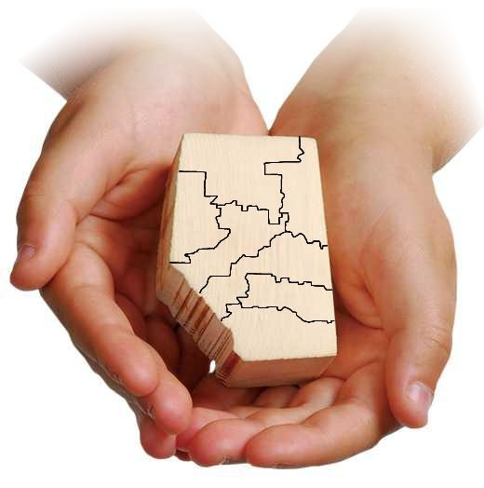
Alberta Regional Plans
The government of Alberta encourage a shift toward :
Cumulative Effect Management System(CEMS)
Integrated Resource Management (IRM)
Land Use Framework (LUF)(2008)
Alberta Land Stewardship Act(ALSA)(2009)
is facilitated
Create the framework and the legal basis for
Alberta Regional plans

Slide 5
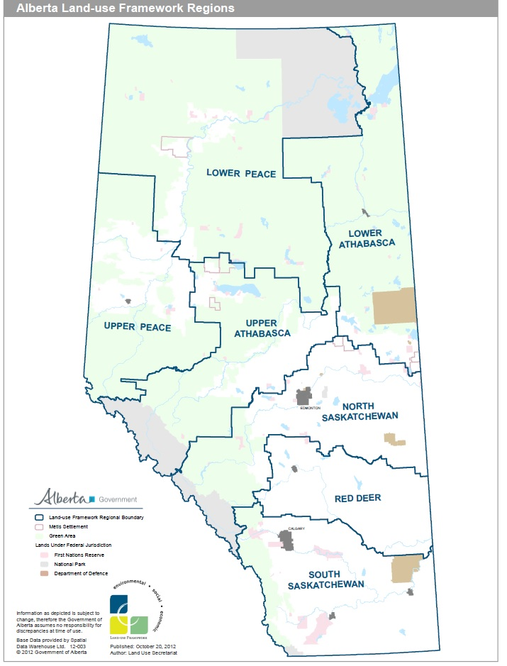
Alberta Regional Plans
Seven regions are created based on watershed and municipals' boundaries (The map retrieved directly form ESRD Website, 2014)
Regional Plans
Employ cumulative effects management approach to identify target and thresholds
Manage land, water, air, and biodiversity
Balance economic, environment, and social goals

Slide 6
Alberta Regional Plans
Alberta Regional Plans are designed
with control and command (top-down) management structure
IRM emphasise on
dynamic interplay of power
move toward multi agent/ actor decision making process
Water for Life Strategy, which
facilitate a transition management from government to governance by introducing water governance partnership
Concerns were raised about how the integration will happen

Slide 7
Research questions?
How did the fairness of regional planning process perceive in Alberta by public and stakeholders (water partnerships ) ?
What are critical components of fair planning process in Alberta's regional plans?
How do critical components of fair planning process components are interconnected?
√

Slide 8
Literature review
Social Psychology:
Social justice: fair and equitable allocation of bargaining powers, resources, and burdens in society (Prilleltensky and Nelson, 1997 )
Social Justice
Equity
Procedural Justice
Distributive Justice
philosophical: proportionality or egalitarianism
the evaluation of whether an outcome was just
characteristics of decision making process

Slide 9
Literature review
There are three main theories that have effective impact on current researches on procedural justice
Theories | Main Themes
Theory of procedure(1) (Thibaut and Walker, 1975) | “Legal process has to resolve conflicts in such a way as to bind up the social fabric and encourage the continuation of productive exchange between individuals” (Greenberg and Colquitt, 2005, p.22).
Justice judgment theory (2) (Leventhal, 1980) | “Procedural rule is defined as an individual’s belief that allocative procedure which satisfy certain criteria are fair and appropriate” (Leventhal,1980,p.30).
Group value model(3) (Lind and Tyler, 1988) | Identification of distributive justice and procedural justices. Procedural justice focuses on how decision are made

Slide 10
procedural justice principles
Unbiased Framework
Accuracy of information-2,3
Bias –suppressionl-2
Informative Procedure
Providing Knowledge-3
Preparing public for effective participation -3
Easy to operate-3
Consistency-2
Legitimate Representative
Unbiased selection of agents-2
Right to participant (Solum,2004)
Equal opportunity to participant-2
Active Participation
Voice-2,3
Control on process- 2,3
Control on making final decisions -2,3
Resolving Conflict
Identifying shared value -3
Fair decisions-3
Providing compensation-2
Correctability -2

Slide 11
Qualitative research method
Procedural justice sits in the context of moral and philosophical aspect of human psychology.
Many scholars uses qualitative method to conduct the research*.
Four sources has been used for data collection
Government documents
Law and regulation
In-depth interviews
Local /Provincial Government
Public documents
Observations
Regional planning document
Regional Advisory Council
Stakeholder
Blog Posts
Websites
Stakeholders meeting
Public meeting
Water conversation
*Lawrence, et al. (1997), Lukasiewicz et al. (2013), Syme et al.(2001)(2005)

Slide 12
Qualitative research method
Data Analysis
Thematic Analysis
Content Analysis
2-Create a Node’s hierarchy structure
3- Creating the themes
4- Compering themes with the Key words and Criteria from literature
1-Code in NVivo (paragraph or sentences)
1-Use a word query
2-Create a Node’s from the result of the word Query
3- Create a Node`s hierarchy structure
4- Creating the themes
5- Compering themes with the Key words and Criteria from literature
*Lawrence, et al. (1997), Lukasiewicz et al. (2013), Syme et al.(2001)(2005)

Slide 13
Procedural justice critical components
Identified procedural justice components are categorized :
a fair plan design process
a fair public participation process
a fair decision making process

Slide 14
Procedural justice critical components
Identified procedural justice components are categorized :
G1: designing a fair process
T1= Procedural rules
T2= Fair vision and objectives
G2: fair public participation
T3= Unbiased representative
G3: a fair decision making process
T6= Clear description of decision makers responsibilities
T4= Clear public participation strategies
T5= Voice
T7= Understand and resolve the conflicts
T8= Identify the implementation challenges

Slide 15
Results: Procedural rules
According the key informants, public documents and government document a fair planning process should follow procedural rule:
The most important component in this theme :
Accuracy of information
Consistent
Transparent
Used the accurate information
Easy to understand and easy to follow
Suppress the bias and personal influence
Procedural rules *
Easy to understand
*Lukasiewicz et al. (2013),

Slide 16
Results: Procedural rules

Slide 17
Results: Fair vision and objectives
The results show a fair planning process should have
a fair vision,
clear objectives and intent
In case of Alberta regional planning process :
Cumulative Effect Management System(CEMS)
Integrated Resource Management(IRM)
Clarification of the current regional vision and objective
Clarification of the current definition public participation and consultation
A fair vision and objectives *
*Lawrence, et al. (1997), Lukasiewicz et al. (2013), Syme et al.(2001)(2005)

Slide 18
Procedural justice critical components

Slide 19
Results: Unbiased representative
A fair consultation process need a unbiased representative:
~70 percent of the key informants and ~ 40 percent of public documents
Unbiased selection of Regional Advisory council (RAC)*
Clarifying RAC’s responsibilities
Unbiased representative *
* RAC’s member are selected by the government of Alberta to represent the region and not representing their interest groups.

Slide 20
Result: Clear public participation strategies and Voice
A strong public participation strategies leads to a fair planning process :
Advertising public participation opportunities
Using effective public engagement tools
Using focus group strategy to mange public participation
Voice promote s the perception of fair process .
More than 50% of the key informants and public documents
Value of the public input
Bilateral Communication with planners and the governments
Voice

Slide 21
Result: Clear description of decision makers responsibilities
Although decision making process is top – down,
the perception of fair planning process can improve :
Clarity in roles and responsibilities of Land Use Secretariat* and Cabinet
Limiting lobbying and restricting making political decision
Clarity of decision making authority
*
* The Land Use Secretariat's as a part of public service of Alberta (not a government department) is responsible for:
preparing the regional plans,
facilitating the implementation of the plan,
and reviewing and monitoring

Slide 22
Result: Resolve the conflicts and implication challenges
The fair decision making process pro-actively tries to resolve conflicts and disputes (Syme, et. al 2001).
understanding the value conflicts and gaps,
designing a appealing system and providing compensation, (correct-ability)
Resolve conflict
Identify implication challenges during the planning promote s the perception of fair process .
More than 50% of the key informants from water stakeholders believe:
Implementation challenge
lack of guidance on using current institutional resources (partnerships)
the provincial budget cuts in various environmental sector

Slide 23
Result:
This research identified 22 procedural justice components in Alberta regional plans :
Plan design (G₁)
Public consultation process (G₂)
Decision making process (G₃)
Theme 1
Theme 2
Theme3
Theme4
Theme5
Theme6
Theme7
Theme 8
Consistency
CEMS
Unbiased selection of RAC
Advertising Public Participation Opportunities
Value of the public input
Clarifying role of Land use Screteriate and Cabinet
Understanding the value conflicts and gaps
Not using current institutional resources
Transparency
IRM
Clarifying RAC’s responsibilities
Bilateral communication
Accuracy
Clear Vision and objectives
Using effective public engagement tools
Limiting lobbying and making political decisions
Correctability
Budget cuts in various environmental sector
Easy to understand
Clear Definition of public participation
Minimizing bias
Using focus group strategy to manga public participation

Slide 24
Conclusion
Decision making process has direct impact on not only the procedural justice but also distributive Justice (Syme, et al , 2005).
Despite the fact the Alberta regional plan use CEMS* and IRM* the decision making process is designed top – down.
More over, with legal support of ALSA* all legislations about water, land, air, and biodiversity will fall under the Alberta's regional plans
Cabinet who make the final decision have the whole power
* CEMS= Cumulative effect management system
* IRM= Integrated Resource Management
* ALSA= Alberta Land Stewardship Act

Slide 25
Suggestions
Improving the perception of procedural justice
affect the acceptance the plans’ outcome
enhance the public trust
In case of Alberta regional plans :
Two plans are approved and in process to be approved
Five more plans still not started.
Decrease implementing challenges
Improve the public acceptance
Improve the fairness of the process

Slide 26
Thank you
Parastoo.emami@uleth.ca

Slide 27
References
[1] Jonathan A Allan. Water in the environment/socio-economic development discourse:
Sustainability, changing management paradigms and policy responses in a global system.
Government and Opposition, 40(2):181–199, 2005.
[2] Paula Antunes, Giorgos Kallis, Nuno Videira, and Rui Santos. Participation and evaluation
for sustainable river basin governance. Ecological Economics, 68(4):931–939,
2009.
[3] Robert Bewer. Recreational ecosystem service benefits from the Chestermere lake reservoir:
value for day use non- resident vision. University of Lethbridge, 2012.
Henning Bjornlund. The competition for water: Striking a balance among social,
environmental, and economic needs. CD Howe Institute, 2010.
[5] Henning Bjornlund and Peter Rossini. Climate change, water scarcity and water markets:
Implications for farmers’ wealth and farm succession. In Proceedings from the
16th annual conference of the Pacific Rim Real Estate Society, 2010.
[6] Randall W Block and Joel Forrest. Gathering storm: Water conflict in alberta, a. Alta.
L. Rev., 43:31, 2005.
[7] Ian Calder. Blue revolution: Integrated land and water resources management. Routledge,
2012.
[8] J.C. Caldwell and Loyola University Chicago. Critical Factors in Social Justice Orientation
Development. Loyola University Chicago, 2008.
[9] Christine Carpenter and Melinda Suto. Qualitative research for occupational and physical
therapists: A practical guide. Blackwell Pub., 2008.

Slide 28
References
[10] Madonna G Constantine, Sally M Hage, Mai M Kindaichi, and Rhonda M Bryant. Social
justice and multicultural issues: Implications for the practice and training of counselors
and counseling psychologists. Journal of Counseling & Development, 85(1):24–
29, 2007.
[11] Alberta Water Council. Alberta’s water management system: Policy issues and gaps.
2006.
[12] Ian Craddock, Alan William Preece, RajagopalDept NILAVALAN, Jack Albert Leendertz,
Ralph Benjamin, Frederick John9 Sprats Barn Crescent Wilson, et al. Methods
and apparatus for measuring the internal structure of an object, December 5 2012. EP
Patent 1,850,743.
[13] John W. Creswell. Research Design: Qualitative, Quantitative, and Mixed Methods
Approaches. SAGE Publications, 2009.
[14] RC de Loë. A canadian vision and strategy for water in the 21st century. Policy
Options, 30(7), 2009.
[15] Robert C De Loë. From Government to Governance: A State-of-the-art Review of
Environmental Governance: Final Report. Rob de Loë Consulting Services, 2009.
[16] Neil M Drew, Brian J Bishop, and Geoff Syme. Justice and local community change:
Towards a substantive theory of justice. Journal of Community Psychology, 30(6):623–
634, 2002.
[17] Alberta Environment. Cold lake-beaver river basin groundwater quantity and brackish
water state of the basin report. 2006.
[18] Alberta Environment. Water for renewal. 2008.
[19] Alberta Environment. Water for life action plan. 2009.

