Slide 1
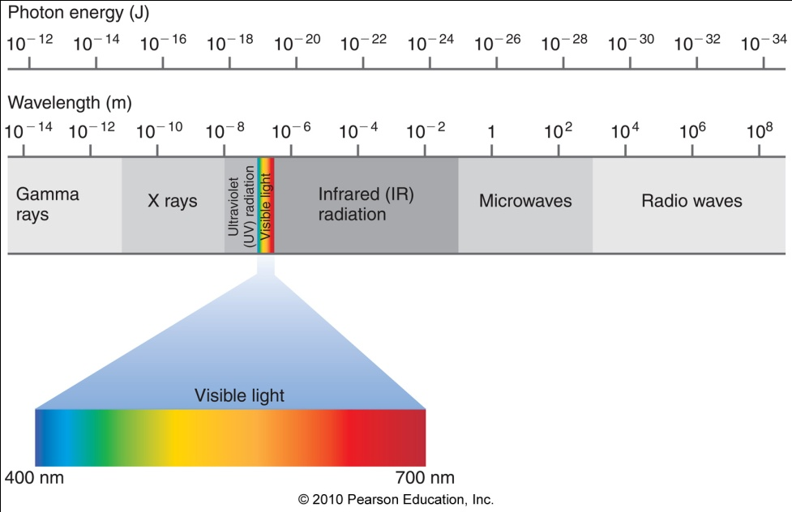
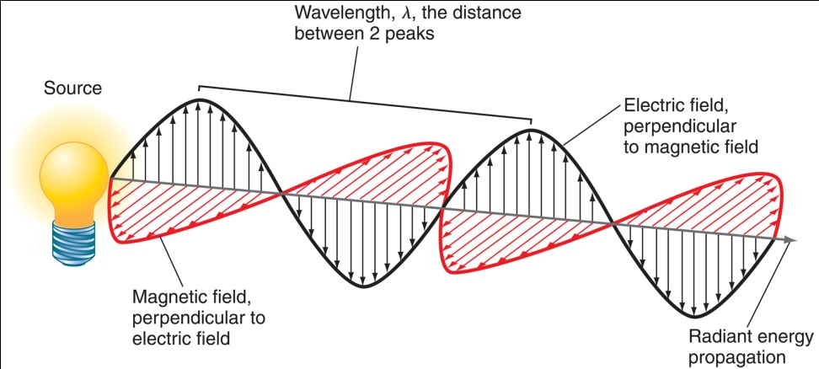
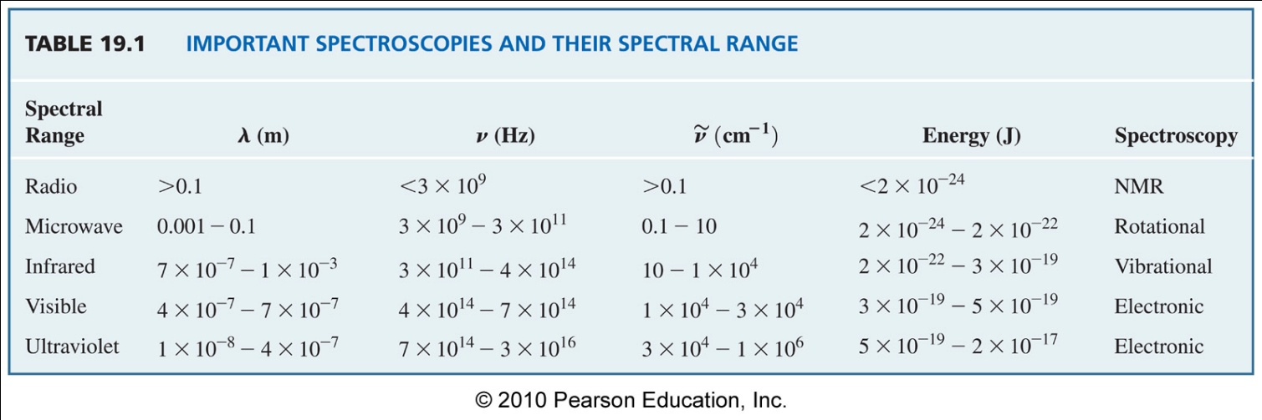
Spectroscopy
The Light Spectrum

Slide 2
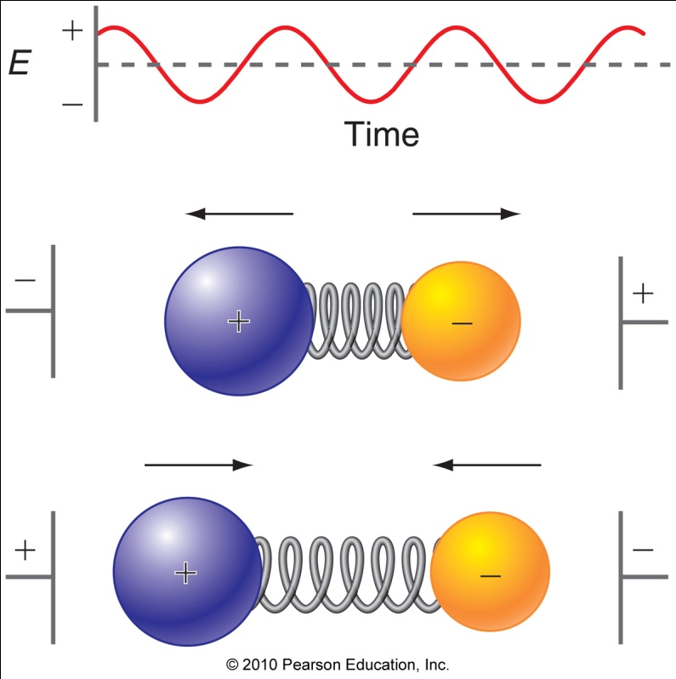
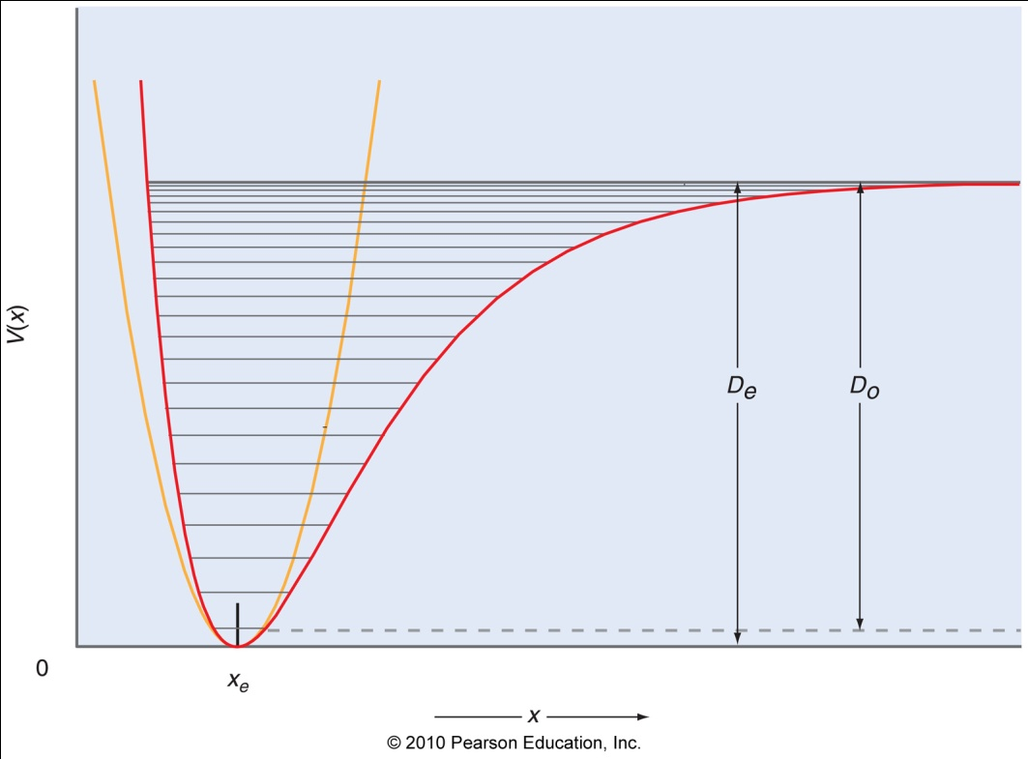
Vibrational Spectroscopy
r(t)
D(t)
The higher the BO: i) the deeper the Well, ii) the wider the spacing between vibrational states, and iii) the higher the frequency.

Slide 3
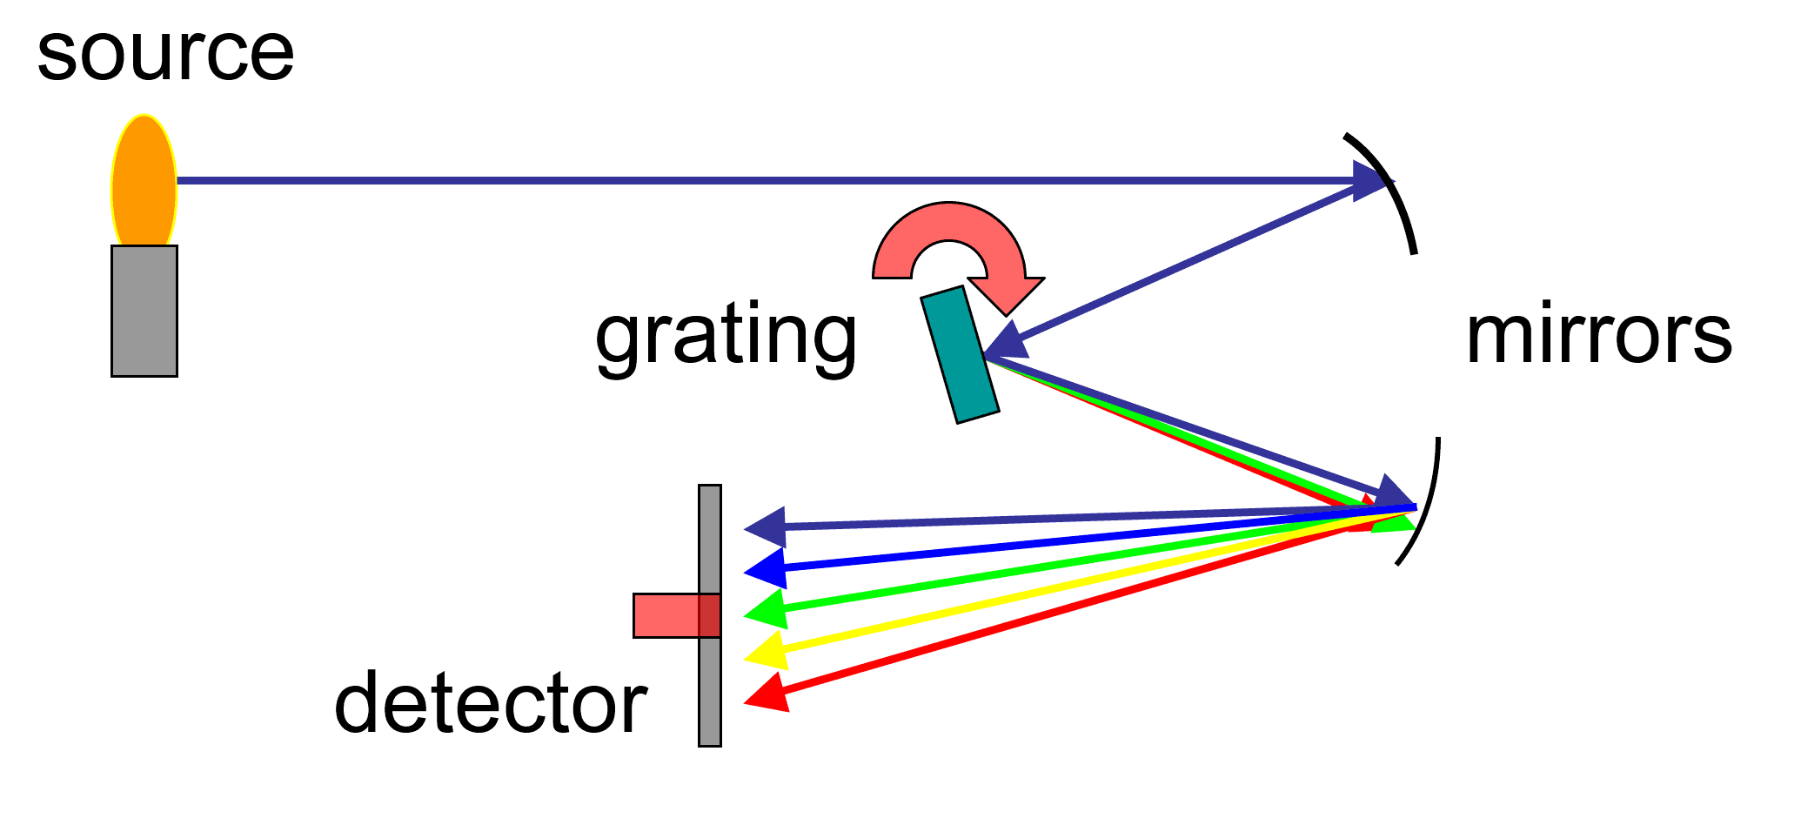
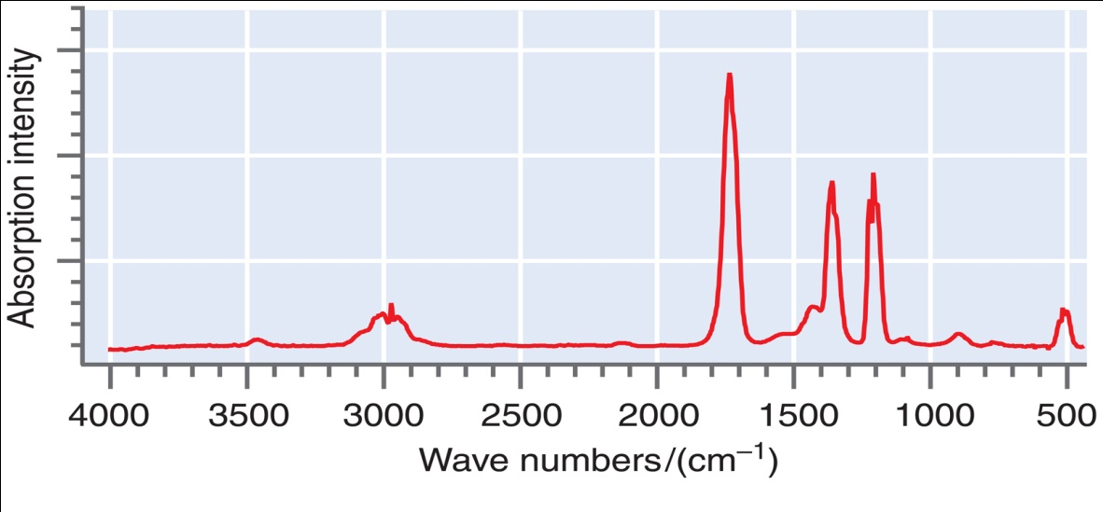
Scanning Infrared Spectrometer
I = Sample
I₀ = Blank
θ
= Determines wavelength selected
Absorption
Grating Orientation (θ)

Slide 4
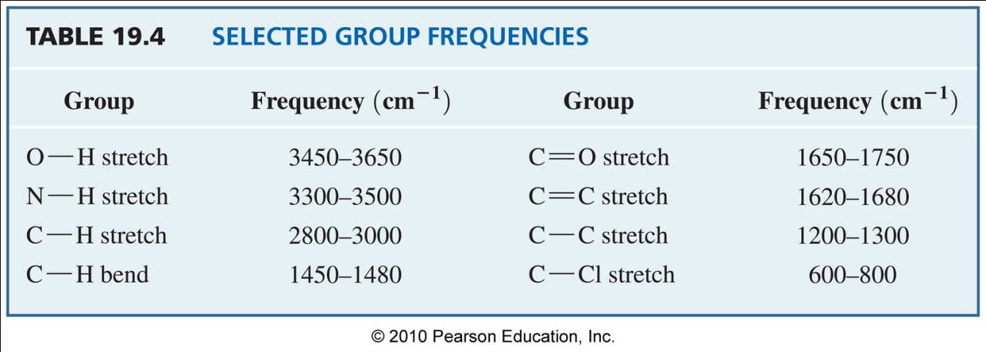
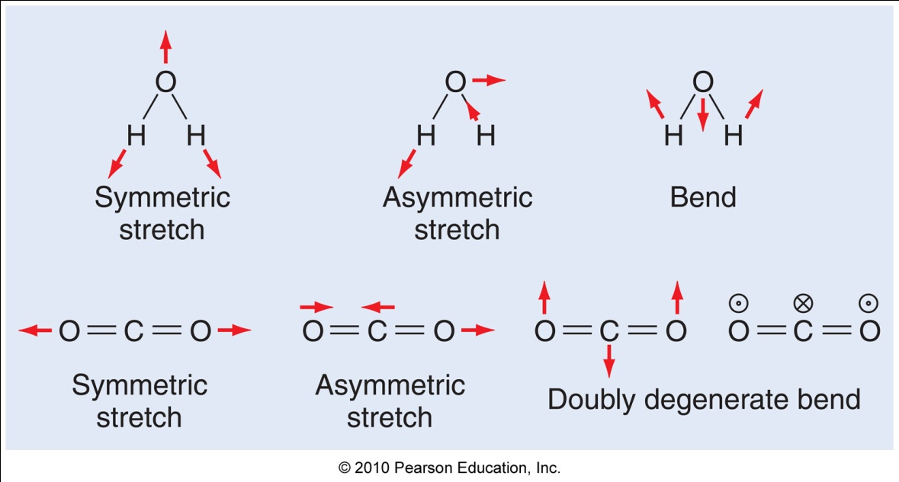
Vibrational Spectra of Molecules
C=O
C-H
C-C
Internal motion must cause the dipole to modulate to
be observable.
Ex) CO₂
Symmetric vs asymmetric stretch
Ex) Water
Symmetric vs asymmetric stretch
O-H
C-H
Reduced Mass
= frequency ~ 1/λ (1/cm)
Wave numbers
λ = wave length (cm)
k related to Bond Order !!!

Slide 5
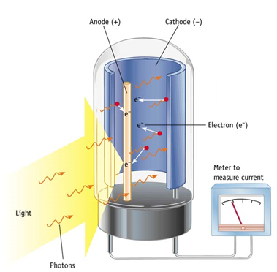
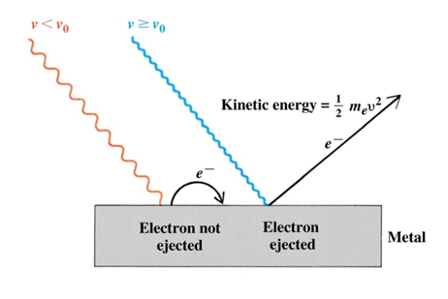
Photoelectron Spectroscopy
Another form of spectroscopy can be used to corroborate the orbital occupancies predicted by MO theory–
Photoelectron Spectroscopy (PES).
The principles behind photoelectron spectroscopy are the same as those behind the photoelectric effect:

Slide 6
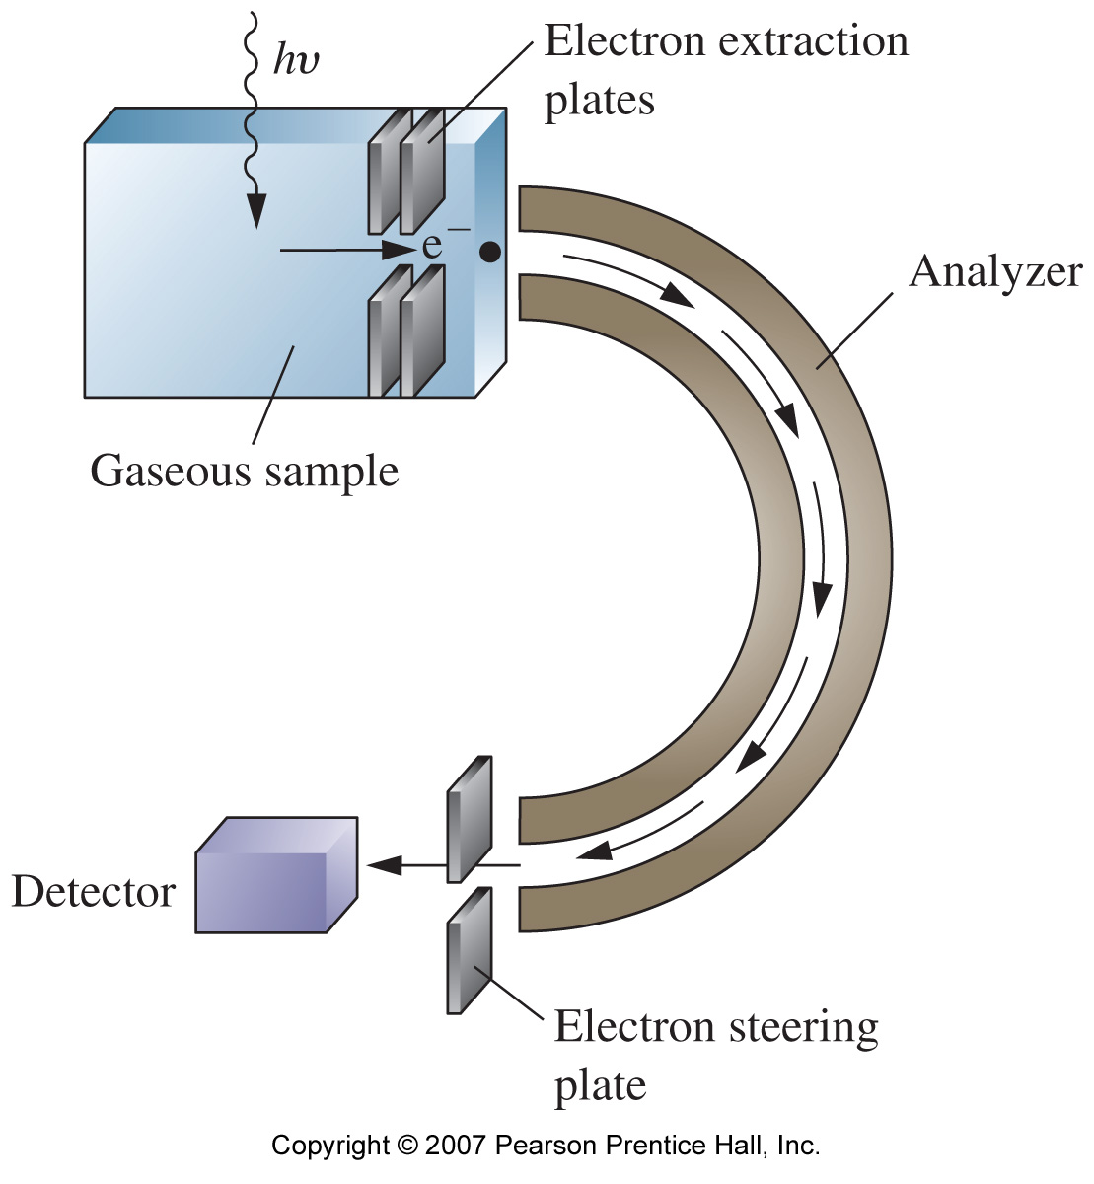
Photoelectron Spectroscopy
The energies involved typically fall in ultraviolet region
hence PES is often referred to as UPES (ultraviolet photoelectron spectroscopy) spectrometer.
Similar to a mass spectrometer.
UV to X-ray
K.E. (electron) = hν_{UV} - IE
IE = Ionization Energy
KE = Kinetic Energy = 1/2 mv²

Slide 7
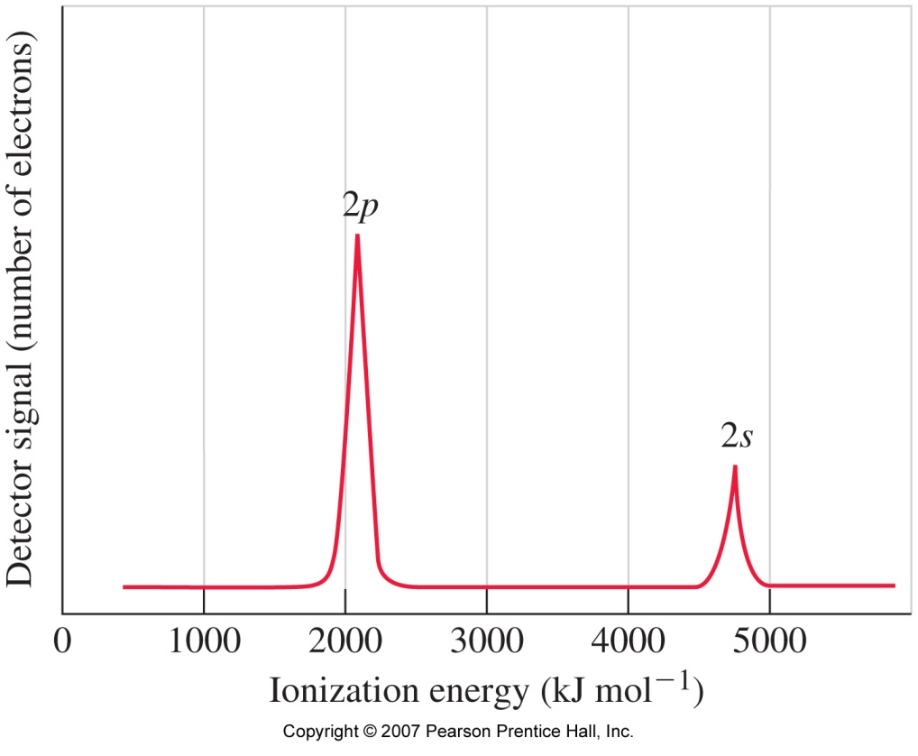
Photoelectron Spectroscopy of Neon
High
KE
Low
KE
Unbound
State
O
Low
IE
hν
2p
High IE
2s
The PES spectrum Neon is very simple, showing only one line for each orbital.

Slide 8
Photoelectron Spectroscopy of Neon
High
KE
Low
KE
Unbound
State
O
Low
IE
hν
2p
High IE
If in this UV PES a source with wavelength of 20 nm is used what would be the kinetic energy of an electron removed from the 2s and 2p orbitals. Would 30 nm still work?
2s
K.E. (electron) = hν_{UV} – IE
We need ν_{uv} and EI from 2s and 2p orbitals

Slide 9
Photoelectron Spectroscopy of Neon
ν = c/λ = (3.0*10⁸ m/s)/(20*10⁻⁹ m) = 1.5*10¹⁶ s⁻¹
From the PES Spectrum: EI (2s) = 4750 kJ/mol & EI (2p) = 2100 kJ/mol
K.E.(2s) = hν_{UV} – IE(2s)
= (6.626*10⁻³⁴ Js)(1.5*10¹⁶ s⁻¹) – (4,750,000 J/mol)/(6.02*10²³ mol⁻¹)
= 9.93*10⁻¹⁸ J – 7.89*10⁻¹⁸ J = 2.05*10⁻¹⁸ J 1 eV = 1.602*10⁻¹⁹ J
= (2.05*10⁻¹⁸ J) / (1.602*10⁻¹⁹ J/eV) = 12.8 eV
K.E.(2p) = hν_{UV} – IE(2p)
= 9.93*10⁻¹⁸ J – (2,100,000 J/mol)/(6.02*10²³ mol⁻¹)
= 9.93*10⁻¹⁸ J – 3.49*10⁻¹⁸ J = 6.44*10⁻¹⁸ J
= (6.44*10⁻¹⁸ J)/ (1.602*10⁻¹⁹ J/eV) = 40.2 eV

Slide 10
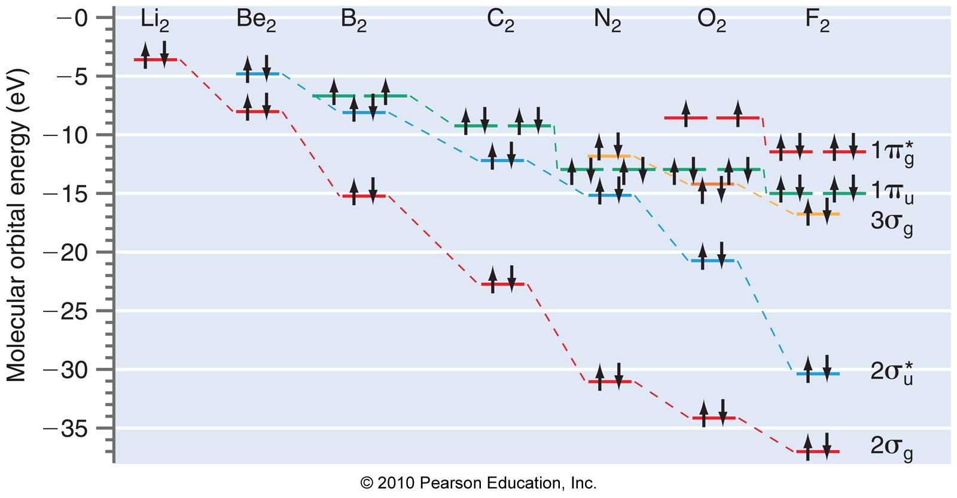
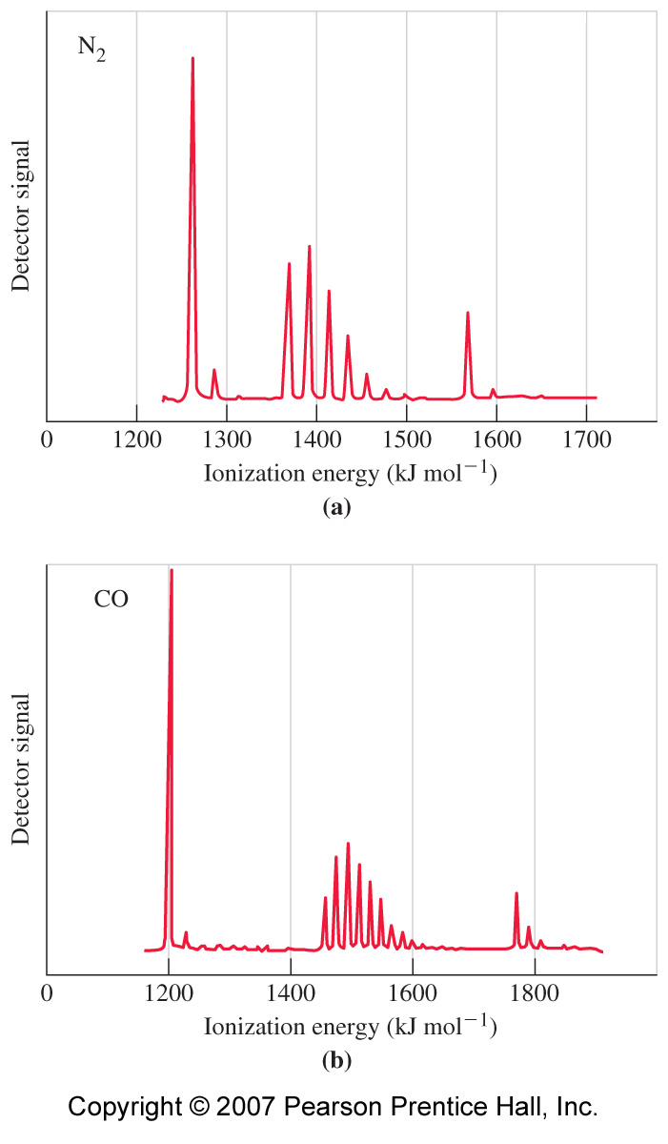
Photoelectron Spectroscopy of Diatomic Molecules
O₂
3σ
2π∗
1π
2π∗
1π
3σ
N₂
3σ
2σ∗
1π
2σ∗
1σ

Slide 11
Vibrational Fine Structure
The PES spectrum of diatomics are more complex resulting from the are vibrational energy levels.
Without vibrational energy levels the lines in the PES spectrum would not be split as seen with neon.
When the UV photon is absorbed, and electron is emitted additional vibrational transitions take place from the ground state vibrational state of the molecule to an excited vibrational state of the cation.
The change in vibrational state reduces the KE of the electron ejected as a consequence of the conservation of energy.
Hence there is a distribution of KE’s of the electron from a particular MO is according to the vibrational transitions that are possible.
The spacing in the lines corresponds vibrational frequency of the cation, which depends on its bond order.
The bond order of the cation is determined by the type of MO from which the electron is removed.
18
H₂⁺
17
16
15
Ionization Energy (eV)
H₂
0
0
1
2
r (Å)

Slide 12
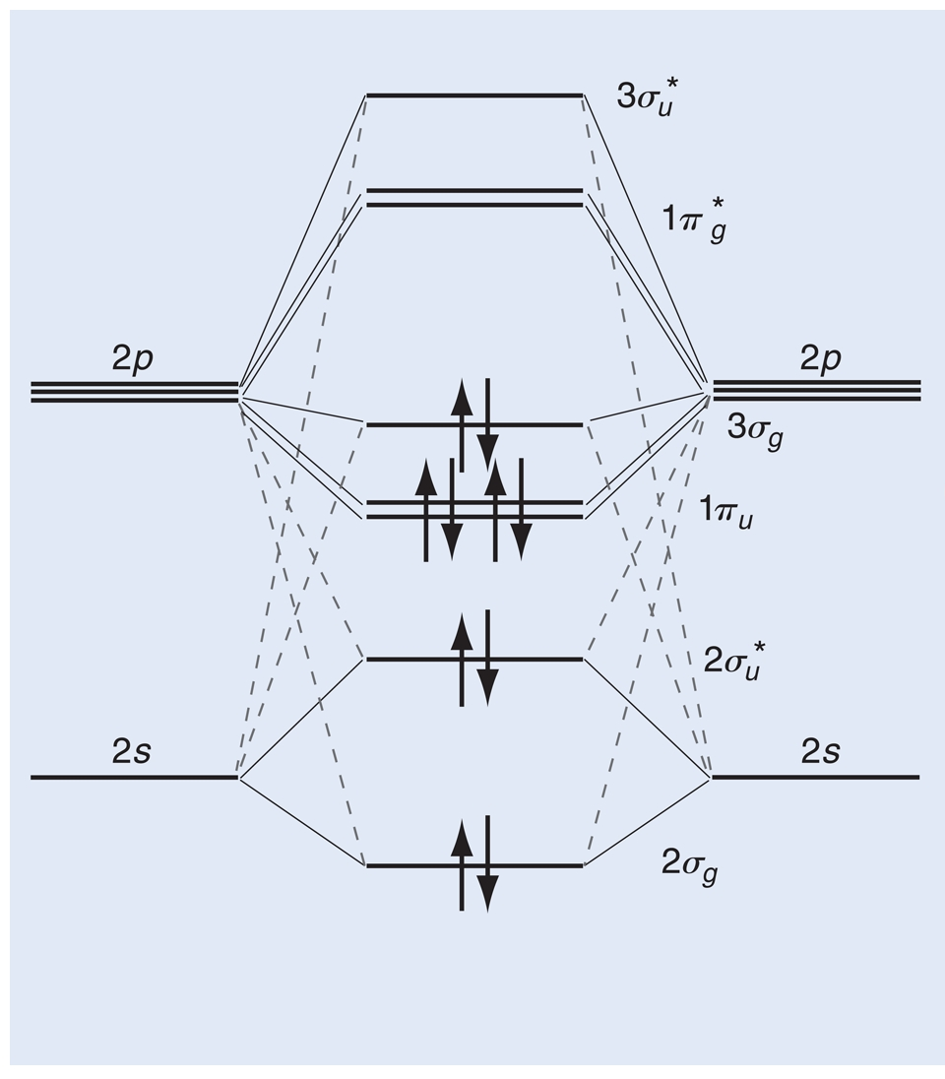
Vibrational Fine Structure
Vibrational fine structure indirectly gives the vibrational spectrum for the cation produced.
Comparison of the two vibrational spectra tells us how the bond was affected:
  i) Loss of a nonbonding electron: the bond order changes little.
  ii) Loss of a bonding electron: the bond order is reduced, hence the line spacing is smaller.
  iii) Loss of an antibonding electron: The bond order increases, hence the line spacing increases.
Photoelectron spectroscopy allows us to measure energies of orbitals – as well as confirming behaviour predicted by MO.
Example: N₂ 2360 cm⁻¹
3σ 2191 cm⁻¹ 1π 1850 cm⁻¹ 2σ* 2397 cm⁻¹.
The bonding in 3σ is a weaker than in 1π.
4σ∗
2π∗
3σ
1π
2σ∗
1σ

Slide 13
Experimental Evidence for MO Predictions
N₂
CO
3σ
3σ(−)
4σ∗
1π(+)
4σ∗
1π
2σ∗
2σ∗(++)
2π∗
2π∗
3σ (3σ_{nb})
3σ
1π
As the vibrational frequency of N₂⁺ is higher (2360 cm⁻¹) than CO⁺(2184 cm⁻¹), the splitting is wider.
The spacing for 3σ signal is 2210 cm⁻¹. Slight increase?
Likely non-bonding.
The spacing for 1π signal is 1450 cm⁻¹. Large decrease.
Definitely Bonding.
The spacing in the 2σ∗ for CO is 1630 cm⁻¹. Large decrease.
Definitely Bonding.
Scenario 2 is most consistent with the data
1π
2σ∗
2σ∗
(2σ)
1σ
1σ
(?)
PES shows N₂ and CO are isoelectronic.

Slide 14
High Resolution UV PES Spectrum of CO
ν(CO⁺) = 2184 cm⁻¹
2σ*
1π
3σ
1449 cm⁻¹
1634 cm⁻¹
2213 cm⁻¹
0.180 ev
0.275 ev
0.203 ev
Ionization Energy (eV)
Gardner and Sampson, (1975) J. Chem. Phys. 62, 1447.

